Slide 1

Department of Computer Engineering
Advance Machine Learning
01CO1301
4 Credits
Ravikumar R Natarajan

Slide 2
At the end of the course, students will be able to:
To understand key concepts, tools and approaches for pattern recognition on complex data sets.
To learn Kernel methods for handling high dimensional and non-linear patterns.
To implement state-of-the-art algorithms such as Support Vector Machines and Bayesian networks.
To Solve real-world machine learning tasks: from data to inference.
To apply theoretical concepts and the motivations behind different learning frameworks.
Course Outcomes

Slide 3
Department of Computer Engineering
Key Concepts
Unit #1

Slide 4
Supervised/Unsupervised Learning
Loss functions and generalization
Probability Theory
Parametric vs Nonparametric methods
Elements of Computational Learning
Theory Ensemble Learning
Bagging
Boosting
Random Forest
Content

Slide 5
ML is an interdisciplinary field:
Data Analyst: visualize, analyze data, optimization
Data Engineers: build and test scalable/stable/optimal ecosystems for data scientists to run their algorithms
Database Administrator: responsible for the proper functioning of all the databases.
Data Scientist: perform predictive analysis and offer actionable insights.
Statistician: extract and offer valuable insights from the data using statistical theory and tools.
Machine Learning Introduction

Slide 6
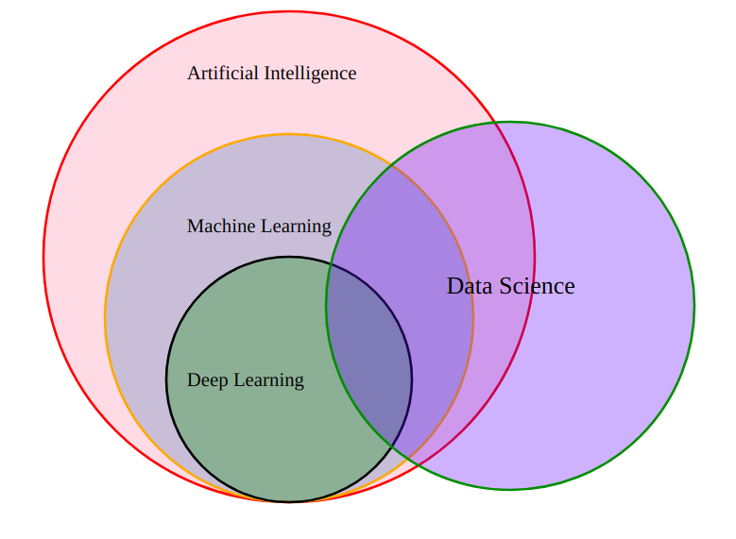
AI enables the machine to think (autonomous
decision making)
AI vs ML vs DL vs DS
ML generates predictions from the data using
Statistical tools.
DS is to extract valuable information
from the data
DL is to mimic human brain. MNN – multi neural network
architecture

Slide 7
AI stands for Artificial Intelligence, and is basically the study/process which enables machines to mimic human behaviour through particular algorithm.
ML stands for Machine Learning, and is the study that uses statistical methods enabling machines to improve with experience.
DL stands for Deep Learning, and is the study that makes use of Neural Networks(similar to neurons present in human brain) to imitate functionality just like a human brain.
Data science is the field of applying advanced analytics techniques and scientific principles to extract valuable information from data for business decision-making, strategic planning and other uses.
Machine Learning Introduction

Slide 8
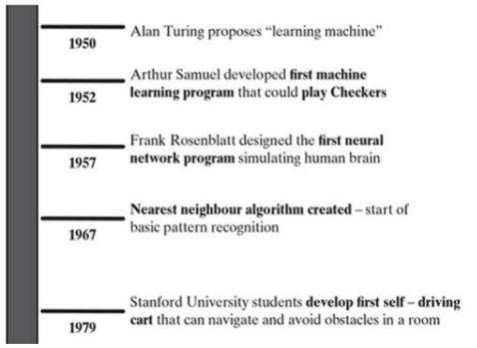
Evaluation of Machine Learning
Machine Learning Introduction

Slide 9
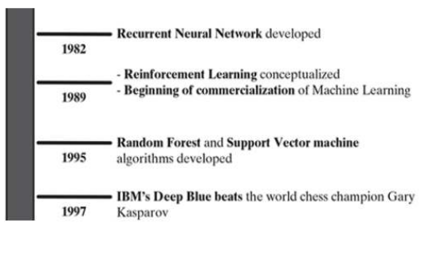
Evaluation of Machine Learning
Continued
Machine Learning Introduction

Slide 10
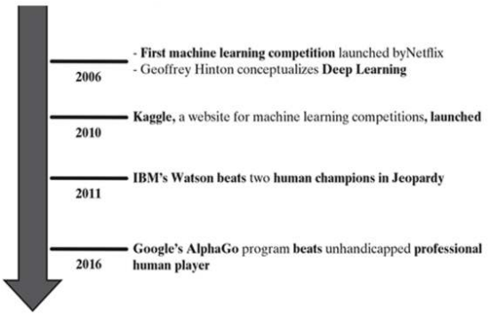
Evaluation of Machine Learning
Continued
Machine Learning Introduction

Slide 11
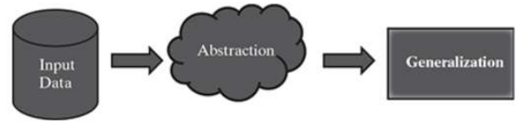
Data Input: Past data or information is utilized as a basis for future decision-making.
Abstraction: The input data is represented in a broader way through the underlying algorithm.
Generalization: The abstracted representation is generalized to form a framework for making decisions.
How do machine learn?
Notes:
i.e. abstract the knowledge which comes as input data in
the form of a model. (Training).
The generalization part is to tune up the
abstracted knowledge to a form which can be used to
take future decisions.

Slide 12

AIBO
Sony created a series of robotic pets called Aibo. It was built in 1998. Although most models sold were dog-like, other inspirations included lion-cubs. It could express emotions and could also recognize its owner. In 2006, Aibo was added to the Carnegie Mellon University’s ‘Robot Hall of Fame’. A new generation of Aibo was launched in Japan in January 2018.
https://us.aibo.com
Did You Know?

Slide 13
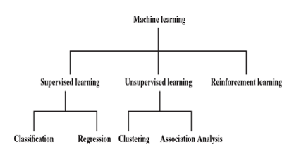
Types of Machine Learning

Slide 14
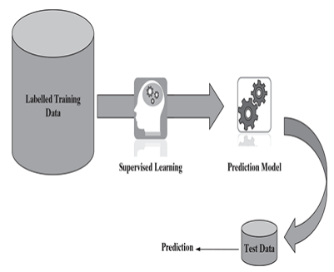
Supervised Learning

Slide 15
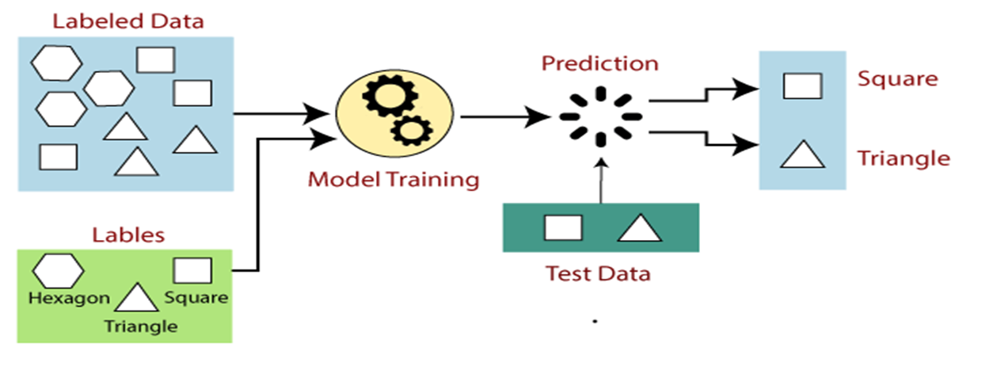
Supervised Learning
Supervised learning is the types of machine learning in which machines are trained using well "labelled" training data, and on basis of that data, machines predict the output.
The labelled data means some input data is already tagged with the correct output.
Supervised Learning

Slide 16
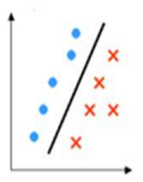
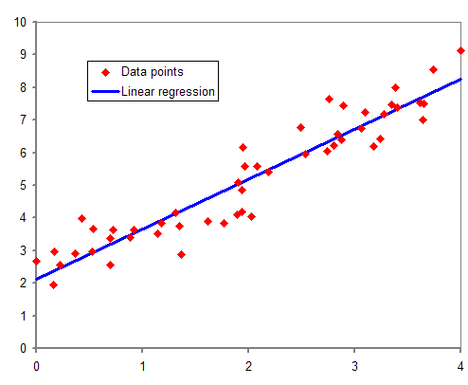
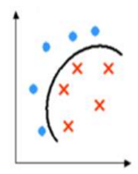
Classification (Discrete value output) | Regression (Predict real value output)
Types of Supervised Learning

Slide 17
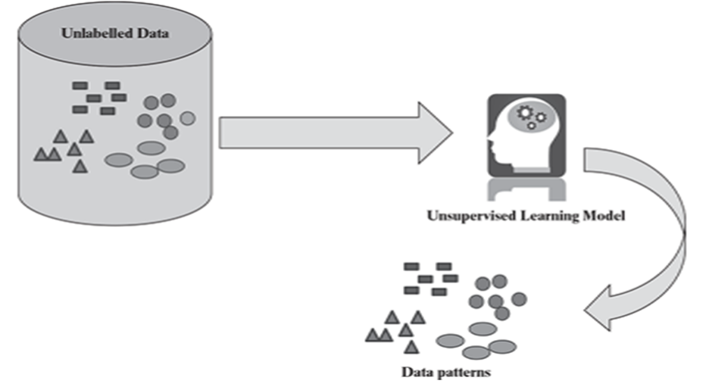
Unsupervised learning is a machine learning technique in which models are not supervised using training dataset.
Instead, models itself find the hidden patterns and insights from the given data. It can be compared to learning which takes place in the human brain while learning new things.
Unsupervised Learning

Slide 18
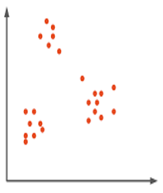
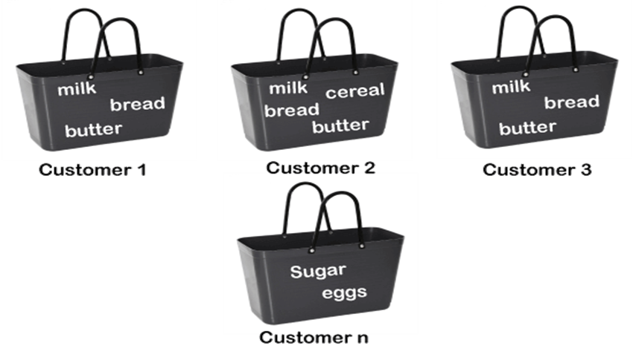
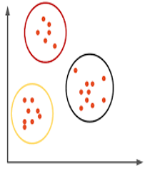
Clustering | Association
Types of Unsupervised Learning

Slide 19
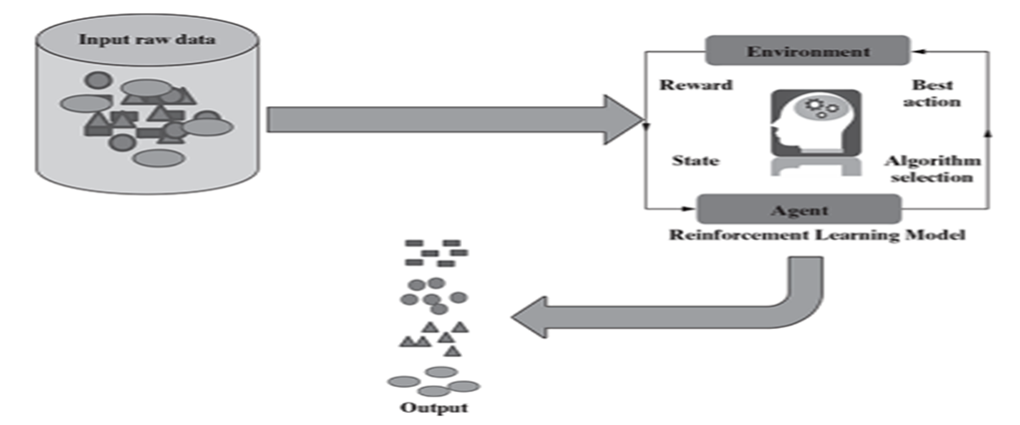
Reinforcement Learning is a feedback-based (reward) Machine learning technique in which an agent learns to behave in an environment by performing the actions and seeing the results of actions.
For each good action, the agent gets positive feedback, and for each bad action, the agent gets negative feedback or penalty.
Reinforcement Learning

Slide 20
Comparison – Supervised, Unsupervised and Reinforcement Learning
Criteria | Supervised ML | Unsupervised ML | Reinforcement ML
Definition | Learns by using labelled data | Trained using unlabelled data without any guidance. | Works on interacting with the environment (reward based)
Type of data | Labelled data | Unlabelled data | No – predefined data
Type of problems | Regression and classification | Association and Clustering | Exploitation or Exploration
Supervision | Extra supervision | No supervision | No supervision
Algorithms | Linear Regression, Logistic Regression, SVM, KNN, NB, DT. | K – Means, PCA, DBSCAN, Apriori | Q – Learning, SARSA
Aim | Calculate outcomes | Discover underlying patterns | Learn a series of action
Application | Risk Evaluation, Forecast Sales | Recommendation System, Anomaly Detection | Self Driving Cars, Gaming, Healthcare
Supervised vs
Unsupervised vs
Reinforcement Learning
Notes:
State–action–reward–state–action (SARSA)

Slide 21
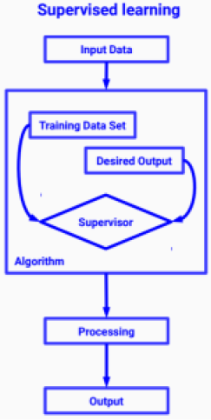
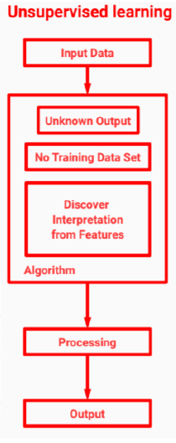
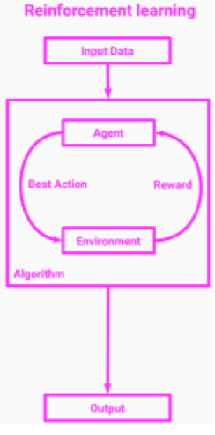
Guess the types??
Supervised Learning

Slide 22
Many video games are based on artificial intelligence technique called Expert System.
This technique can imitate areas of human behaviour, with a goal to mimic the human ability of senses, perception, and reasoning.
Did you know?

Slide 23
Linear Regression with one Variable: Model and Cost Function, Model representation, Cost Function Parameter Learning: Gradient Descent for single variable

Slide 24
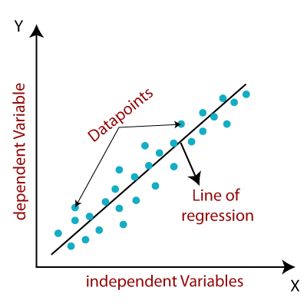
It is a statistical method that is used for predictive analysis. Linear regression makes predictions for continuous/real or numeric variables such as sales, salary, age, product price, etc.
Linear Regression is an approach to show the relationship between the independent variable x and dependent variable y.
y = mx + c
m: slope of line
c: constant
x: Independent variable
y: Dependent variable
Our goal is to find the fit of the line. The best fit means where the error is minimum. It can make our prediction more accurate.
Did you know?
Notes:
https://towardsdatascience.com/linear-regression-part-1-types-examples-gradient-descent-example-2e8c22b05f61#:~:text=Simple%20Linear%20Regression%3A%20It%20is,characterized%20by%20multiple%20independent%20variables.

Slide 25
Types of Linear Regression
Simple Linear Regression
If a single independent variable is used to predict the value of a numerical dependent variable, then such a Linear Regression algorithm is called Simple Linear Regression.
Multiple Linear regression
If more than one independent variable is used to predict the value of a numerical dependent variable, then such a Linear Regression algorithm is called Multiple Linear Regression.
Linear Regression with One Variable
Notes:
https://towardsdatascience.com/linear-regression-part-1-types-examples-gradient-descent-example-2e8c22b05f61#:~:text=Simple%20Linear%20Regression%3A%20It%20is,characterized%20by%20multiple%20independent%20variables.

Slide 26
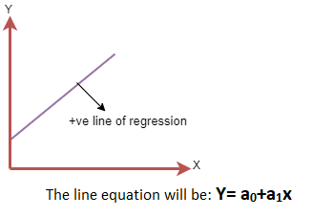
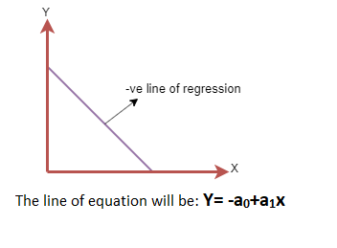
Linear Regression Line
Positive Linear Relationship
Negative Linear Relationship
Linear Regression with One Variable
Notes:
https://towardsdatascience.com/linear-regression-part-1-types-examples-gradient-descent-example-2e8c22b05f61#:~:text=Simple%20Linear%20Regression%3A%20It%20is,characterized%20by%20multiple%20independent%20variables.

Slide 27
How to find “Best Fit” line?
Our main goal is to find the best fit line that means the error between predicted values and actual values should be minimized. The best fit line will have the least error.
The different values for weights or the coefficient of lines (a0, a1) gives a different line of regression, so we need to calculate the best values for a0 and a1 to find the best fit line, so to calculate this we use cost function.
Cost function optimizes the regression coefficients or weights. It measures how a linear regression model is performing.
We can use the cost function to find the accuracy of the mapping function, which maps the input variable to the output variable. This mapping function is also known as Hypothesis function.
For Linear Regression, we use the Mean Squared Error (MSE) cost function, which is the average of squared error occurred between the predicted values and actual values.
Linear Regression with One Variable
Notes:
minimizing the mean squared error (MSE) or the sum of squares of error (SSE), also called the “residual sum of squares.” (RSS)

Slide 28

N=Total number of observation
Yi = Actual value
(a1xi+a0)= Predicted value.
Gradient Descent
Gradient descent is used to minimize (optimize) the MSE by calculating the gradient of the cost function.
A regression model uses gradient descent to update the coefficients of the line by reducing the cost function.
It is done by a random selection of values of coefficient and then iteratively update the values to reach the minimum cost function.
Linear Regression with One Variable
Notes:
https://towardsdatascience.com/linear-regression-part-1-types-examples-gradient-descent-example-2e8c22b05f61#:~:text=Simple%20Linear%20Regression%3A%20It%20is,characterized%20by%20multiple%20independent%20variables.

Slide 29
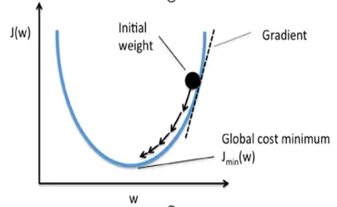
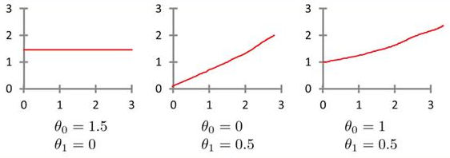
Gradient Descent
Standard Learning Rate
LR = 0.01 (Trial & Error method)
Linear Regression with One Variable
Hypothesis Example: hθ(x) = θ0+ θ1 x the equation of the line θ0,θ1 are parameters and how the effect,
Notes:
https://towardsdatascience.com/linear-regression-part-1-types-examples-gradient-descent-example-2e8c22b05f61#:~:text=Simple%20Linear%20Regression%3A%20It%20is,characterized%20by%20multiple%20independent%20variables.

Slide 30
DEMO -------------- Linear Regression with One Variable
https://colab.research.google.com/drive/13x6JVgXhdbejVywU6bQWS8mV8HL0y7Fo?usp=sharing

Slide 31
Linear Regression with Multiple Variables: Multiple Features Gradient Descent for Multiple Variables

Slide 32

Multiple Linear Regression is one of the important regression algorithms which models the linear relationship between a single dependent continuous variable and more than one independent variable.
Linear Regression with Multiple Variables
Size (feet)² X1 | No.of Bedrooms x2 | No.of Floors x3 | Age of Home x4 | Price ($) y
2104 | 5 | 1 | 45 | 460
1416 | 3 | 2 | 40 | 232
1534 | 3 | 2 | 30 | 315

Slide 33

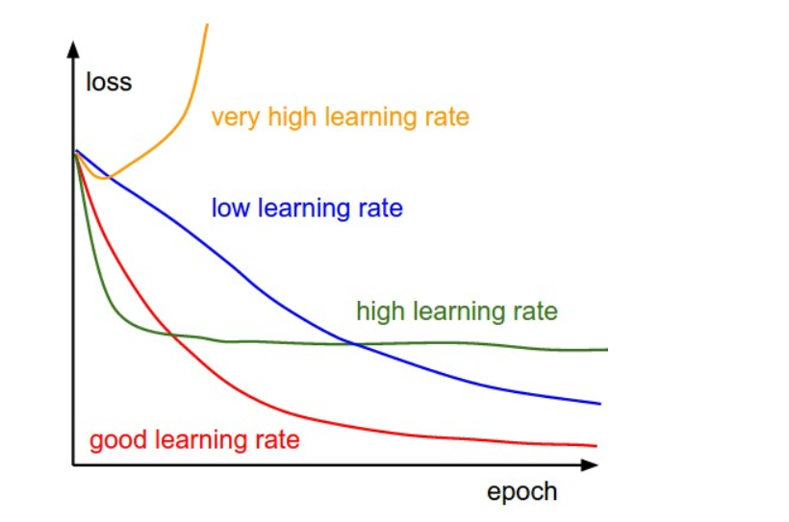
Gradient Descent for Multiple Variables
Cost Function
Linear Regression with Multiple Variables
MSE

Slide 34
DEMO -------------- Linear Regression with Multiple Variables
https://colab.research.google.com/drive/1iqtvvlGkyBk5C5eWKlpGAXkRVbVk-Joi?usp=sharing

Slide 35
Polynomial regression is a form of regression analysis in which the relationship between the independent variable x and dependent variable y is modeled as an nth degree polynomial of x. That is, if your dataset holds the characteristic of being curved when plotted in the graph, then you should go with a polynomial regression model instead of Simple or Multiple Linear regression models.
The equation for Polynomial Regression looks very similar to that of Multiple Linear Regression.
y=b0+b1*x1+b2*(x1)2+....+bn*(x1)n
The main difference is that in Multiple Linear Regression, there are several variables of the same degree but here the single variable has different powers.
Polynomial
Regression

Slide 36
DEMO -------------- Polynomial
Regression

Slide 37
Did you know?
Machine learning saves life – ML can spot 52% of breast cancer cells, a year before patients are diagnosed.
US Postal Service uses machine learning for handwriting recognition.
Facebook’s news feed uses machine learning to personalize each member’s feed.
Did you know?

Slide 38
Loss Functions and Generalization

Slide 39
It’s a method of evaluating how well specific algorithm models the given data.
If predictions deviates too much from actual results, loss function would cough up a very large number.
Gradually, with the help of some optimization function, loss function learns to reduce the error in prediction.
Regression Losses
Mean Square Error/Quadratic Loss/L2 Loss
Mean Absolute Error/L1 Loss
Mean Bias Error
Classification Losses
Hinge Loss/Multi class SVM Loss
Cross Entropy Loss/Negative Log Likelihood
Loss Functions

Slide 40
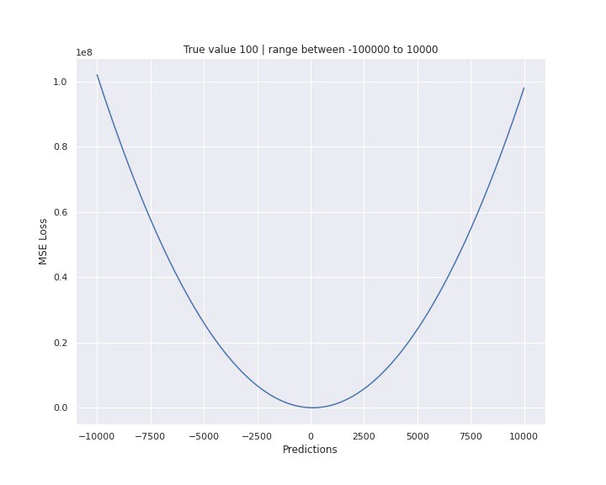
Mean Square Error Loss
It’s the square difference between the current output y_pred and the expected output y_true divided by the number of output.
The MSE function is very sensitive to outliers because the difference is a square that gives more importance to outliers.
If we had to predict one value for all targets, the prediction should be the mean.
Loss Functions
Notes:
Good and easy , useful to calculate Gradient

Slide 41
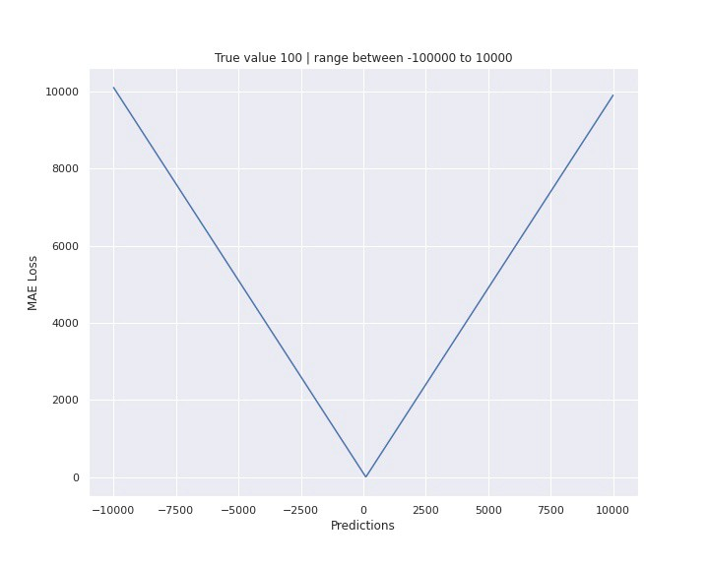
Mean Absolute Error Loss
At the difference of the previous loss function, the square is replaced by an absolute value. This difference has a big impact on the behavior of the loss function which has a “V” form.
It’s like a median, outliers can’t really impact the behavior.
Loss Functions

Slide 42
Mean Bias Error
This is same as MSE with the only difference that we don’t take absolute values.
It could determine if the model has positive bias or negative bias.
Loss Functions

Slide 43
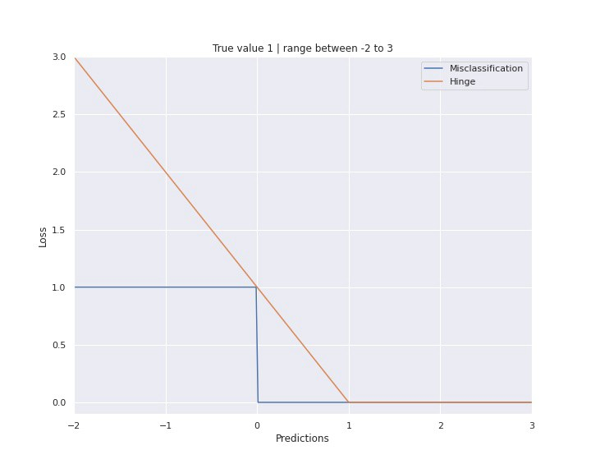
Hinge Loss
The Hinge loss function was developed to correct the hyperplane of SVM algorithm in the task of classification.
The goal is to make different penalties at the point that are not correctly predicted or too closed of the hyperplane.
Loss Functions

Slide 44
Cross Entropy Loss/Negative Log Likelihood
This is the most common setting for classification problems.
Cross-entropy loss increases as the predicted probability diverges from the actual label.
Loss Functions

Slide 45
The term ‘generalization’ refers to a model’s ability to adapt and react appropriately to previously unseen, fresh data chosen from the same distribution as the model’s initial input.
In other words, generalization assesses a model’s ability to process new data and generate accurate predictions after being trained on a training set.
Over-training on training data will prevent a model from generalizing. In such cases, when new data is supplied, it will make inaccurate predictions. Even if the model is capable of making accurate predictions based on the training data set, it will be rendered ineffective.
This is referred to as overfitting.
The contrary is also true (underfitting), which occurs when a model is trained with insufficient data.
Generalization

Slide 46
The ultimate goal of machine learning is to find statistical patterns in a training set that generalize to data outside the training set.
Take the following simple NLP problem: Say you want to predict a word in a sequence given its preceding words.
For example, the sequence “the cat ___” may be followed by
sleeps, enjoys, or wants
For example, the sequence “the plane ____”
We would expect the model to predict departs with a higher probability than depart, and leaves with a higher probability than leave. In that case, the model has learned a pattern that is more generally true.
Generalization

Slide 47
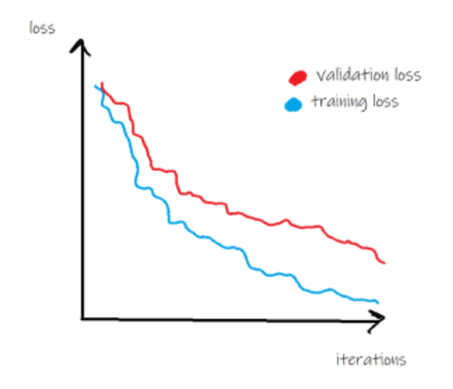
If validation loss decreases as well, the learned patterns seem to generalize.
Generalization
If training loss in fact does decrease as expected, it doesn’t automatically mean that whatever the model has learned is also useful. This is where the validation loss comes into play.
Things look good if the validation loss decreases alongside the training loss. In that case, the learned patterns seem to generalize to the unseen validation data.
The validation loss will typically be higher than the training loss, however, since not all patterns generalize, as you can see in the following graphic.

Slide 48
Bias is defined as the average squared difference between predictions and true values. It’s a measure of how good your model fits the data.
Zero bias would mean that the model captures the true data generating process perfectly. Both your training and validation loss would go to zero. That is unrealistic.
However, as data is almost always noisy in reality, so some bias is inevitable — called the irreducible error.
if losses do not decrease as expected, it probably signals that the model is not a good fit for the data.
For example, if you tried to fit an exponential relationship with a linear model — it can simply not adequately capture that relationship.
Bias

Slide 49
A model is said to have high variance if its predictions are sensitive to small changes in the input.
High variance often means overfitting because the model seems to have captured random noise or outliers.
Variance
Notes:
high bias and underfitting, high variance and overfitting are related as well

Slide 50
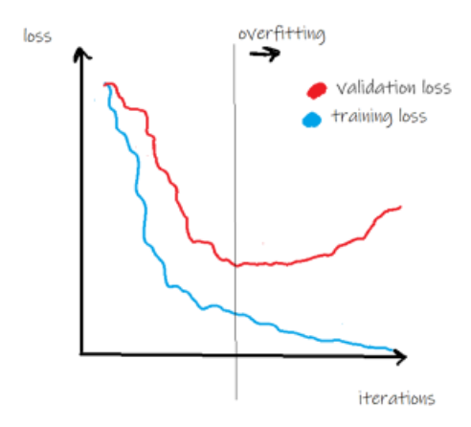
At some point during the training of a model, the validation loss usually levels out (and sometimes even starts to increase again) while the training loss continues to decrease. That signals overfitting.
In other words, the model is still learning patterns but they do not generalize beyond the training set (see graphic below).
Overfitting is particularly typical for models that have a large number of parameters, like deep neural networks.
Overfitting
Notes:
high bias and underfitting, high variance and overfitting are related as well

Slide 51
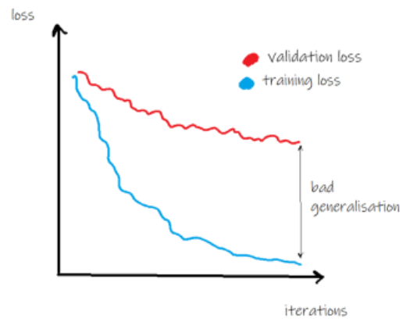
A large gap between training and validation loss is a hint that the model does not generalize well and you may want to try to narrow that gap.
That is to stop the train simplest solution to overfitting is early-stopping , that is to stop the training loop as soon as validation loss is beginning to level off.
Overfitting
Notes:
high bias and underfitting, high variance and overfitting are related as well

Slide 52
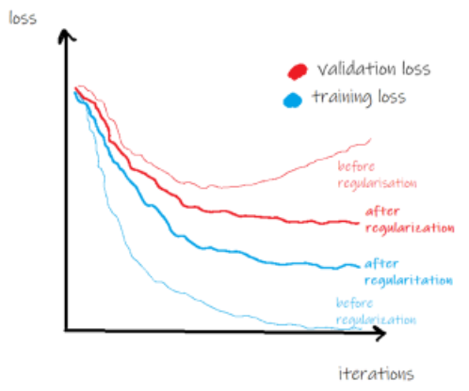
Regularization is a method to avoid high variance and overfitting as well as to increase generalization.
Without getting into details, regularization aims to keep coefficients close to zero (shrinking).
L1 (Lasso) and L2 (Ridge regression) regularization are two widely used methods.
Regularization
Notes:
high bias and underfitting, high variance and overfitting are related as well

Slide 53
Probability Theory

Slide 54
Probability theory describes probabilities in terms of a probability space, typically assigning a value between 0 and 1, known as the probability measure, and a set of outcomes known as the sample space.
Outcomes are often referred to as the results of an event. Probability theory in general attempts to apply mathematical abstractions of uncertain, also known as non-deterministic, processes.
The tools that are common in probability theory are discrete and continuous random variables, probability distributions, and stochastic processes.
What is Probability Theory?
Notes:
high bias and underfitting, high variance and overfitting are related as well

Slide 55
For example: consider that you have two bags, named A and B, each containing 10 red balls and 10 black balls. If you randomly pick up the ball from any bag (without looking in the bag), you surely don’t know which ball you’re going to pick up. So here is the need of probability where we find how likely you’re going to pick up either a black or a red ball.
Conditional Probability
P(Red ball)= P(Bag A). P(Red ball | Bag A) + P(Bag B). P(Red ball | Bag B), this equation finds the probability of the red ball.
What is Probability Theory?
Notes:
high bias and underfitting, high variance and overfitting are related as well

Slide 56
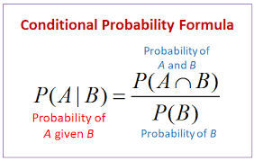
P(Bag A) = 1/2 because we’ve 2 bags out which we’ve to select Bag A.
P(Red ball | Bag A) should read as “probability of drawing a red ball given the bag A” here “given” word specifies the condition which is Bag A in this case, so it is 10 red balls out of 20 balls i.e. 10/20.
P(Red Ball)= 1/2. 10/20 + 1/2. 10/20 = 1/2
Conditional Probability
Notes:
high bias and underfitting, high variance and overfitting are related as well

Slide 57
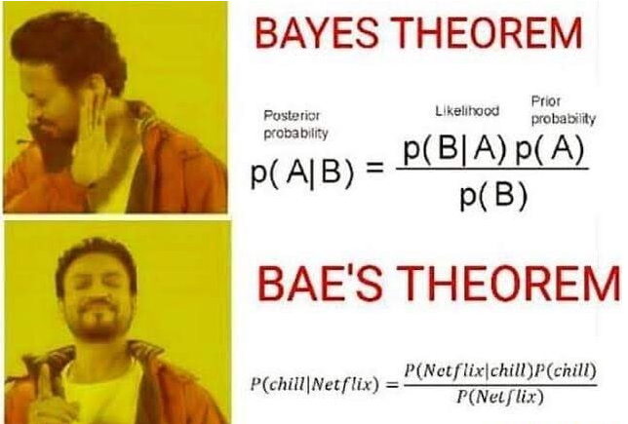
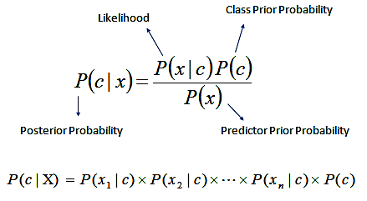
What is Probability Theory?
Notes:
high bias and underfitting, high variance and overfitting are related as well

Slide 58
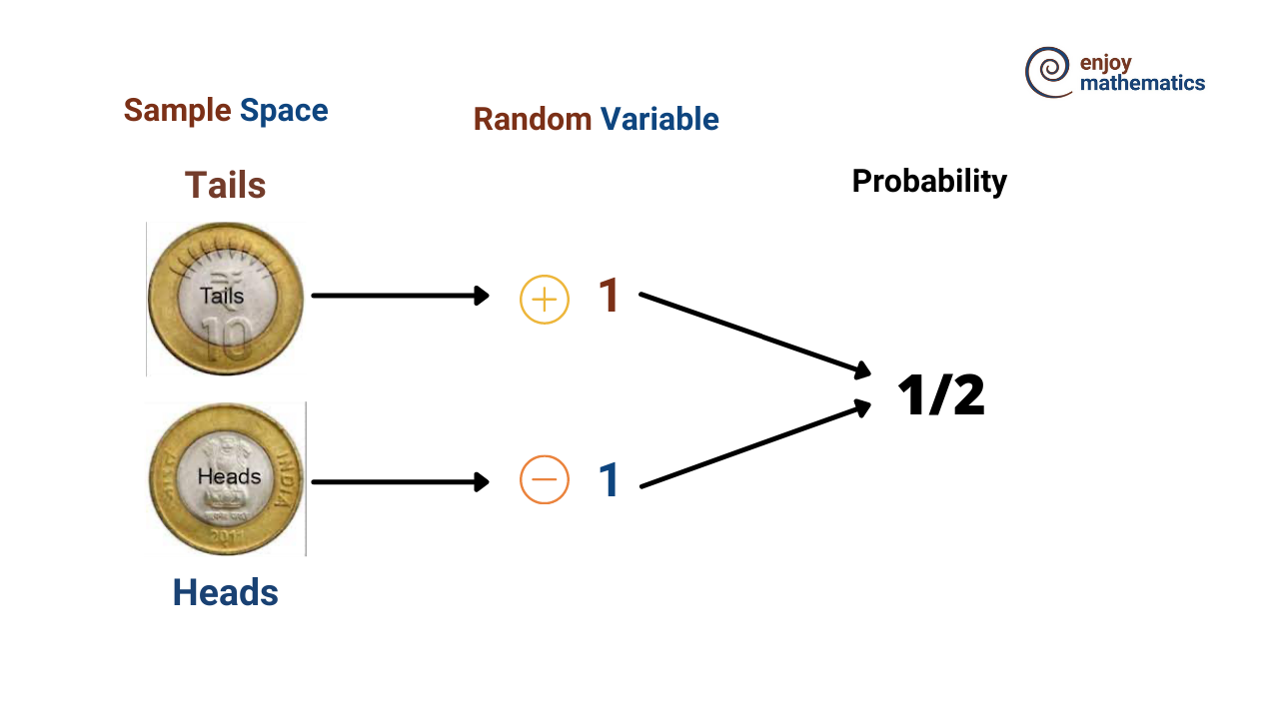
What is Probability Theory?
Notes:
high bias and underfitting, high variance and overfitting are related as well

Slide 59
Naïve Bayes Algorithm Demo
https://colab.research.google.com/drive/1qerX_b8boEeV2ZwpyRSyVaq-r0lmbKm4?usp=sharing
Notes:
https://www.analyticsvidhya.com/blog/2021/01/a-guide-to-the-naive-bayes-algorithm/
high bias and underfitting, high variance and overfitting are related as well

Slide 60
Parametric vs Nonparametric Methods

Slide 61
The basic idea behind the parametric method is that there is a set of fixed parameters that uses to determine a probability model that is used in Machine Learning as well.
Parametric methods are those methods for which we priory knows that the population is normal, or if not then we can easily approximate it using a normal distribution which is possible by invoking the Central Limit Theorem CLT. Parameters for using the normal distribution is as follows:
Mean
Standard Deviation
Confidence interval – is used with mean, SD, population methods to determine the classification.
Examples: Logistic Regression, Naïve Bayes Model, etc.
Parametric Method
Notes:
https://www.analyticsvidhya.com/blog/2021/01/a-guide-to-the-naive-bayes-algorithm/
high bias and underfitting, high variance and overfitting are related as well

Slide 62
The basic idea behind the parametric method is no need to make any assumption of parameters for the given population or the population we are studying.
In fact, the methods don’t depend on the population. Here there is no fixed set of parameters are available, and also there is no distribution (normal distribution, etc.) of any kind is available for use.
This is also the reason that nonparametric methods are also referred to as distribution-free methods.
Low complexity so easy to apply.
Methods:
Spearman correlation test
Sign test for population means
U-test for two independent means
Examples: KNN, Decision Tree Model, etc.
Nonparametric Method
Notes:
https://www.analyticsvidhya.com/blog/2021/01/a-guide-to-the-naive-bayes-algorithm/
high bias and underfitting, high variance and overfitting are related as well

Slide 63
Elements of Computational Learning

Slide 64
Difficulty in ML algorithms.
Capabilities of ML algorithms.
Under what conditions a successful learning is possible/not possible?
We focus here on the problem of inductively learning an unknown target function, given only training examples of the target T and a space of candidate hypothesis.
How many training examples are sufficient to learn the target T. (Sample complexity)
How much computational effort is needed for a learner (Computational complexity)
How many mistakes it makes before it finds the correct hypothesis. (Mistake bound)
Computational Learning
Notes:
https://www.analyticsvidhya.com/blog/2021/01/a-guide-to-the-naive-bayes-algorithm/
high bias and underfitting, high variance and overfitting are related as well

Slide 65
Historically, support vector machines have largely been motivated and analysed using a theoretical framework known as computational learning theory, also sometimes called statistical learning theory.
This has its origins with Valiant (1984) who formulated the probably approximately correct, or PAC, learning framework.
The goal of the PAC framework is to understand how large a data set needs to be in order to give good generalization.
It also gives bounds for the computational cost of learning, although we do not consider these here.
Computational Learning
Notes:
https://www.analyticsvidhya.com/blog/2021/01/a-guide-to-the-naive-bayes-algorithm/
high bias and underfitting, high variance and overfitting are related as well

Slide 66
Theory of Ensemble Learning

Slide 67
Ensemble modeling is a powerful way to improve the performance of your model.
Ensemble learning is a general meta approach to machine learning that seeks better predictive performance by combining the predictions from multiple models.
The three main classes of ensemble learning methods are bagging, stacking, and boosting, and it is important to both have a detailed understanding of each method and to consider them on your predictive modeling project.
Ensemble Learning
Notes:
https://www.analyticsvidhya.com/blog/2021/01/a-guide-to-the-naive-bayes-algorithm/
high bias and underfitting, high variance and overfitting are related as well

Slide 68
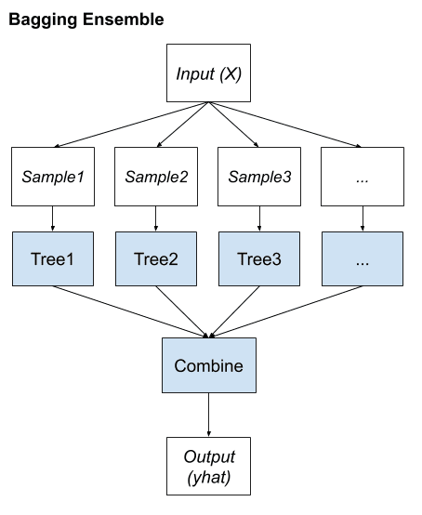
Bagging involves fitting many decision trees on different samples of the same dataset and averaging the predictions.
Bagging
Notes:
https://www.analyticsvidhya.com/blog/2021/01/a-guide-to-the-naive-bayes-algorithm/
high bias and underfitting, high variance and overfitting are related as well

Slide 69
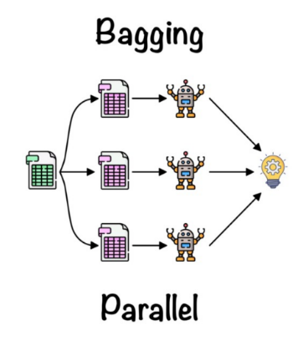
It creates a different training subset from sample training data with replacement & the final output is based on majority voting. For example, Random Forest.
Bagging
Notes:
https://www.analyticsvidhya.com/blog/2021/01/a-guide-to-the-naive-bayes-algorithm/
high bias and underfitting, high variance and overfitting are related as well

Slide 70
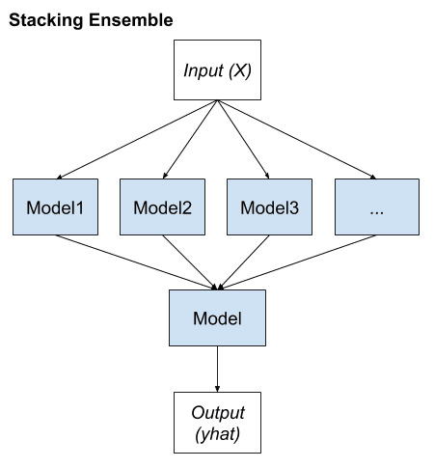
Stacking involves fitting many different models types on the same data and using another model to learn how to best combine the predictions.
Stacking
Notes:
https://www.analyticsvidhya.com/blog/2021/01/a-guide-to-the-naive-bayes-algorithm/
high bias and underfitting, high variance and overfitting are related as well

Slide 71
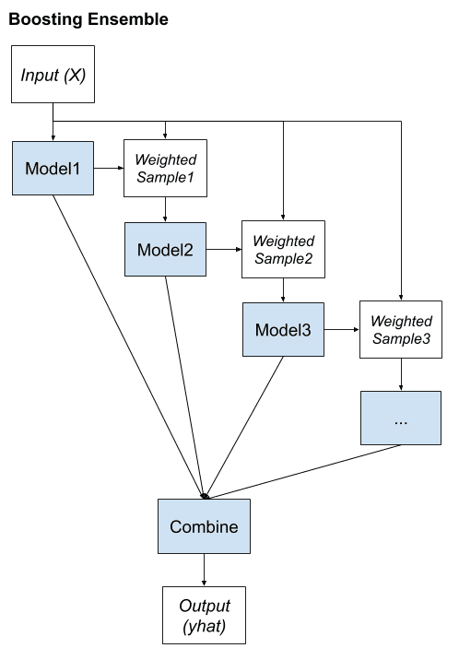
Boosting involves adding ensemble members sequentially that correct the predictions made by prior models and outputs a weighted average of the predictions.
Boosting
Notes:
https://www.analyticsvidhya.com/blog/2021/01/a-guide-to-the-naive-bayes-algorithm/
high bias and underfitting, high variance and overfitting are related as well

Slide 72
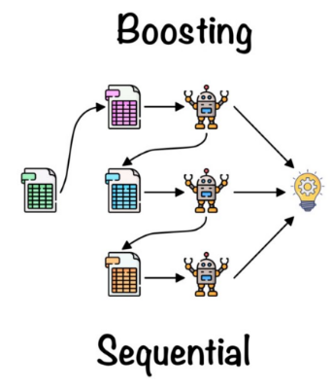
It combines weak learners into strong learners by creating sequential models such that the final model has the highest accuracy. For example, ADA BOOST, XG BOOST
Boosting
Notes:
https://www.analyticsvidhya.com/blog/2021/01/a-guide-to-the-naive-bayes-algorithm/
high bias and underfitting, high variance and overfitting are related as well

Slide 73
Random Forest

Slide 74
Random Forest is a popular machine learning algorithm that belongs to the supervised learning technique.
It can be used for both Classification and Regression problems in ML.
It is based on the concept of ensemble learning, which is a process of combining multiple classifiers to solve a complex problem and to improve the performance of the model.
Advantages:
It takes less training time as compared to other algorithms.
It predicts output with high accuracy, even for the large dataset it runs efficiently.
It can also maintain accuracy when a large proportion of data is missing.
Random Forest
Notes:
https://www.analyticsvidhya.com/blog/2021/01/a-guide-to-the-naive-bayes-algorithm/
high bias and underfitting, high variance and overfitting are related as well

Slide 75
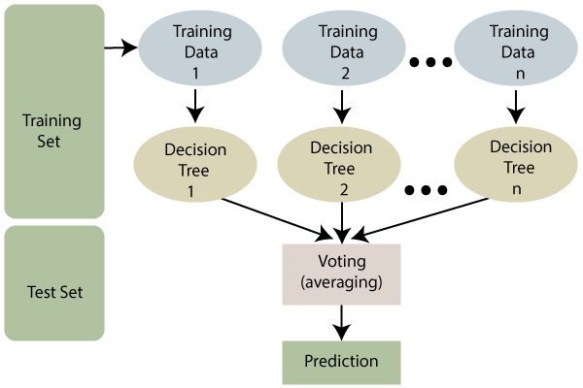
Random Forest
Notes:
https://www.analyticsvidhya.com/blog/2021/01/a-guide-to-the-naive-bayes-algorithm/
high bias and underfitting, high variance and overfitting are related as well

Slide 76
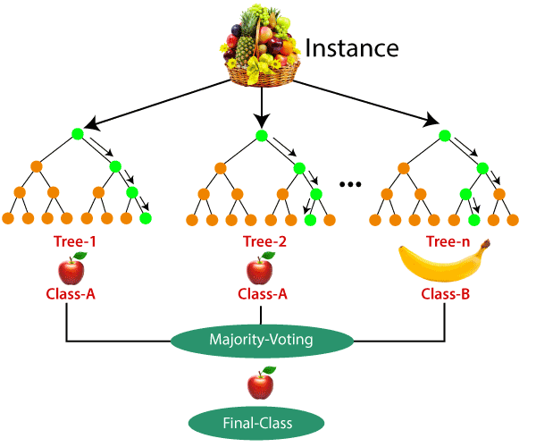
Random Forest
Notes:
https://www.analyticsvidhya.com/blog/2021/01/a-guide-to-the-naive-bayes-algorithm/
high bias and underfitting, high variance and overfitting are related as well

Slide 77
Random Forest
Demo
https://colab.research.google.com/drive/1SMaro_y73SC4WW7ZNUqIxDRw8lcUGmlO?usp=sharing
Notes:
https://www.analyticsvidhya.com/blog/2021/01/a-guide-to-the-naive-bayes-algorithm/
high bias and underfitting, high variance and overfitting are related as well

Slide 78
Supervised Learning
Data-analytics-for-the-identification-of-fake-reviews-using-supervised-learning https://drive.google.com/file/d/11F0360HJ4Zvzig4pegV6_wA7g4Tgjrr6/view?usp=sharing
Deep Transfer Learning Based Classification Model for COVID-19 Disease https://drive.google.com/file/d/1UQyPkNJZt8Af22NUHhsUO7Ztag_61vWO/view?usp=sharing
Predictive-modelling-and-analytics-for-diabetes-using-a-machine-learning-approachApplied-Computing-and-Informatics
https://drive.google.com/file/d/1E9Zqvh0kM23OzILbrWQlMn3X3XWr_E0B/view?usp=sharing
Unsupervised Learning
A Classification Algorithm-Based Hybrid Diabetes Prediction Model https://drive.google.com/file/d/159Q2CKlBF7wELcNlZOGJIiD-yPIqdsZt/view?usp=sharing
Reinforcement Learning
Optimal-deep-reinforcement-learning-for-intrusion-detection-in-UAVs
https://drive.google.com/file/d/1NOxQ636g94HkF2SDGi7VoGz14lV5Lixc/view?usp=sharing
Multiagent-deep-reinforcement-learning-a-surveyArtificial-Intelligence-Review
https://drive.google.com/file/d/1NrKbU-BbwiDKY5b6sqYlCRsxIAZk4a07/view?usp=sharing
Research Papers
References

Slide 79
Kernel Methods for Non-linear Data
Support Vector Machines
Kernel Ridge Regression
Structure Kernels
Kernel PCA
Latent Semantic Analysis
Up Next

Slide 80
End of Unit 1 Thank You.

